Slide 1
Decoders
Abu Humayed Azim Fahmid
Lecturer, CSE Dept., UIU

Slide 2
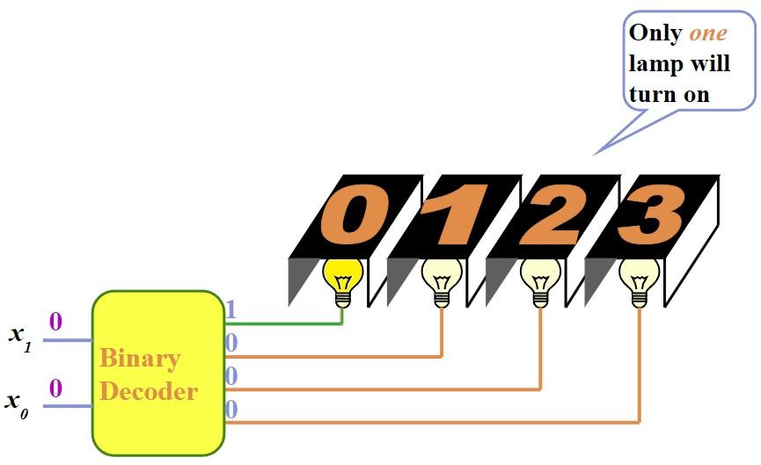
Decoders
Extract “Information” from the code
Binary Decoder
Example: What is meant by a 2-bit Binary Number?

Slide 3
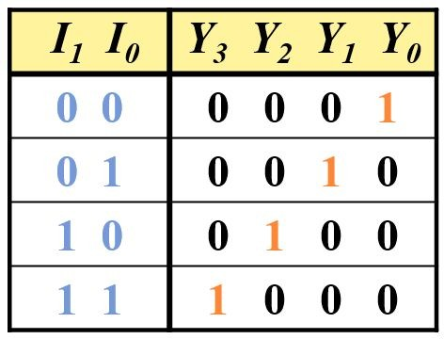
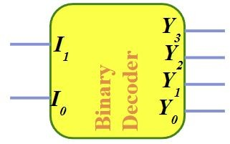
2-to-4 Line Decoder

Slide 4
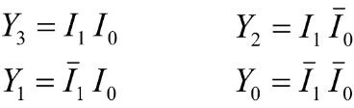
2-to-4 Line Decoder

Slide 5
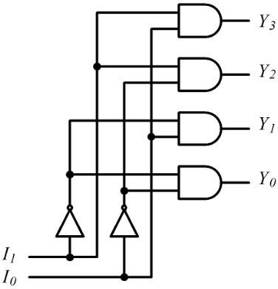
2-to-4 Line Decoder

Slide 6
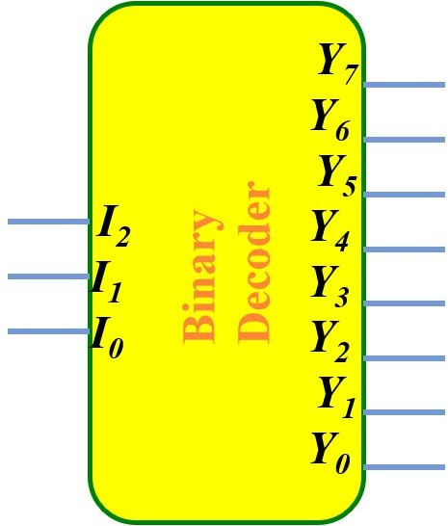
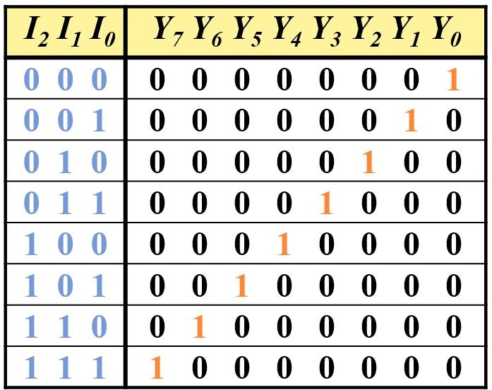
3-to-8 Line Decoder

Slide 7
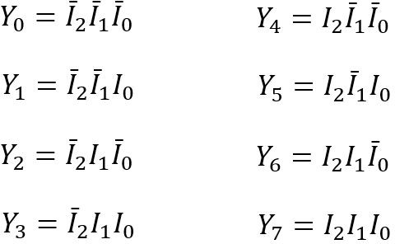
3-to-8 Line Decoder

Slide 8
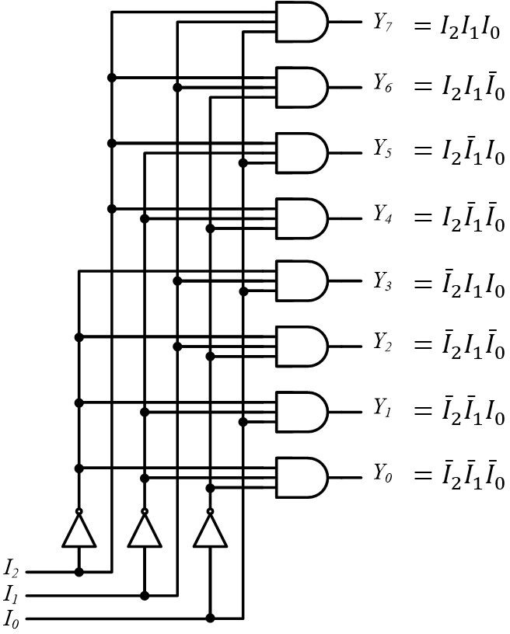
3-to-8 Line Decoder

Slide 9
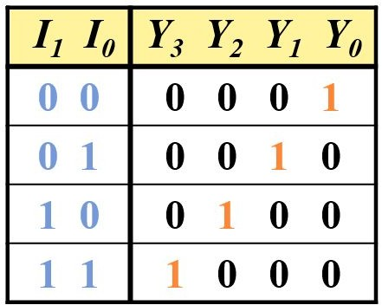
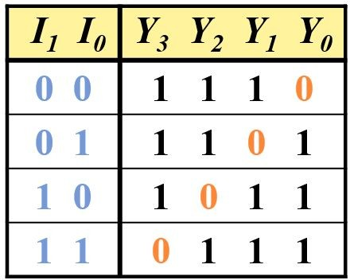
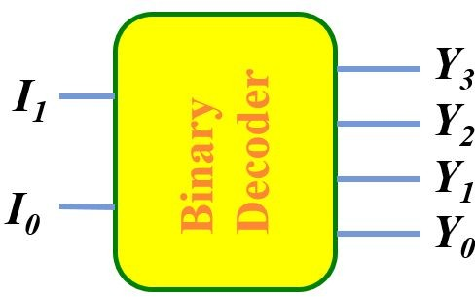
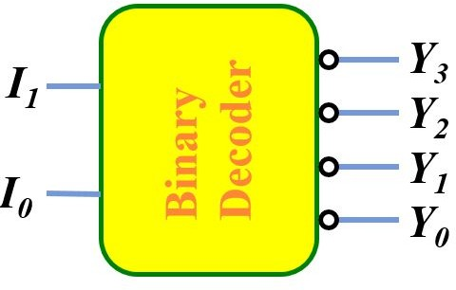
Active-High and Active-Low
Active-High 2-to-4 Line Decoder
Active-Low 2-to-4 Line Decoder

Slide 10
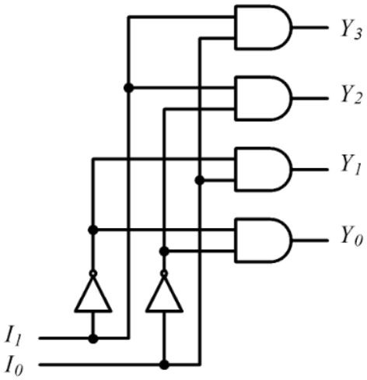

Active-High and Active-Low
Active-High 2-to-4 Line Decoder
Active-Low 2-to-4 Line Decoder

Slide 11
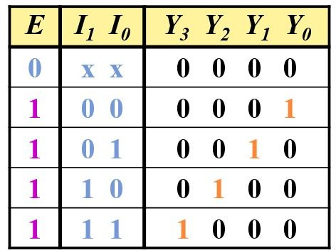
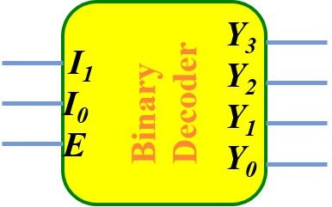
Decoder with Enable Control

Slide 12
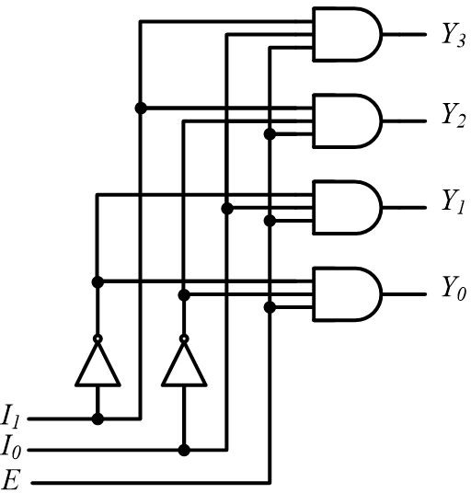
Decoder with Enable Control

Slide 13
Decoder with Enable Control
This is Active-High

Slide 14
Decoder with Enable Control
This is Active-High What about Active-Low?

Slide 15
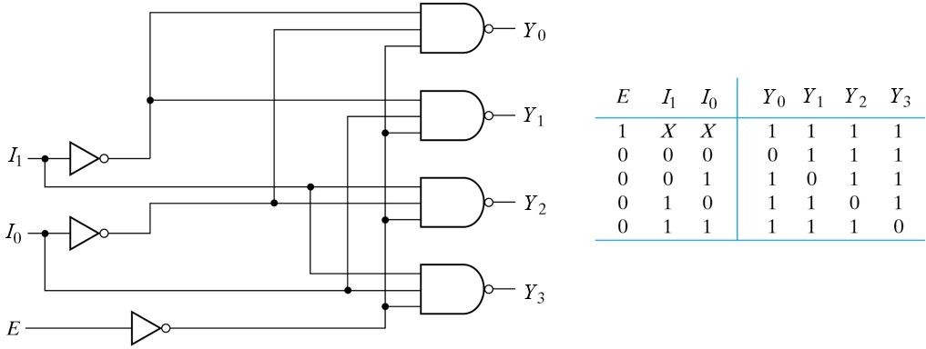
Decoder with Enable Control (Active-Low)

Slide 16
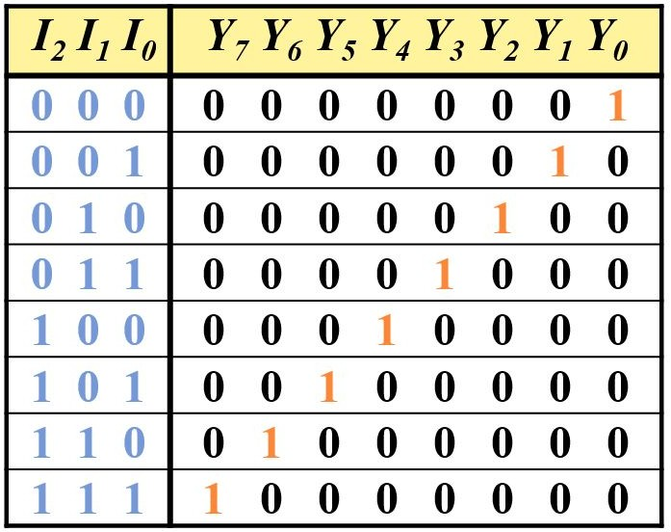
Decoder Expansion
We will now try to make a 3-to-8 Line Decoder using two 2-to-4 Line Decoders.

Slide 17


Decoder Expansion
We will now try to make a 3-to-8 Line Decoder using two 2-to-4 Line Decoders.

Slide 18

Decoder Expansion
We will now try to make a 3-to-8 Line Decoder using two 2-to-4 Line Decoders.

Slide 19
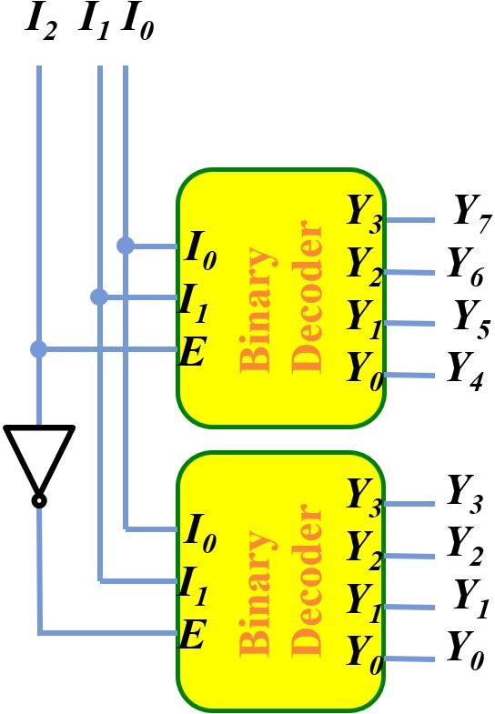
Decoder Expansion

Slide 20
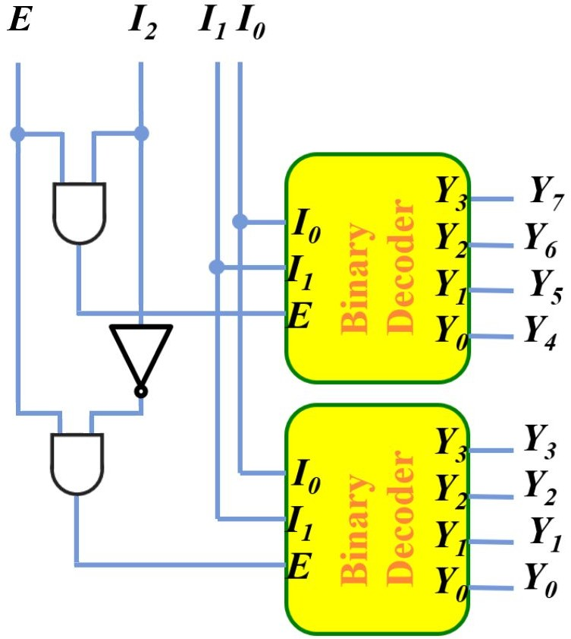
Decoder Expansion
With Enable Control

Slide 21
Function Implementation using Decoder
A decoder provides 2^{n} minterms of n input variables.
Since any Boolean function can be expressed as a sum of minterms, one can use a decoder and external OR gates to implement any combinational function.

Slide 22
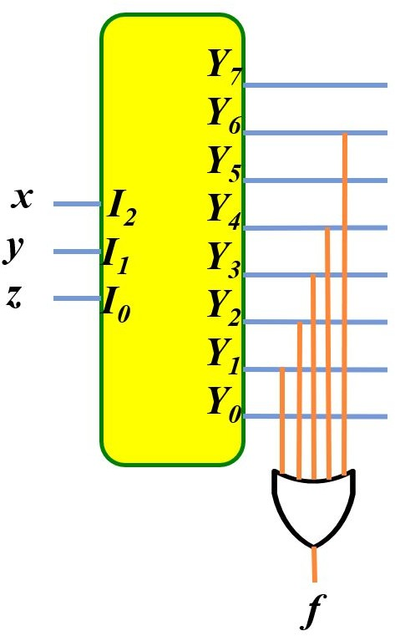
Function Implementation using Decoder
f(x, y, z) = ∑m(1, 2, 3, 4, 6)
Using Active-High

Slide 23
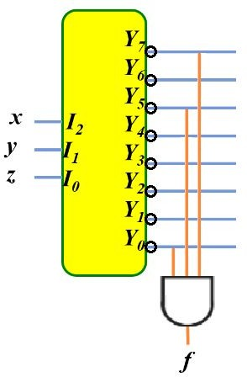
Function Implementation using Decoder
f(x, y, z) = ∑m(1, 2, 3, 4, 6)
= ∏M(0, 5, 7)
Using Active-Low

Slide 24
Function Implementation using Decoder
Try yourself:
f(x, y, z) = ∑m(2, 3, 6, 7)
f(x, y, z) = ∑m(1, 5, 6, 7)
f(x, y, z) = ∑m(0, 4, 5, 7)

Slide 25
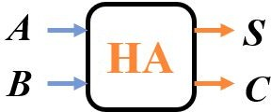
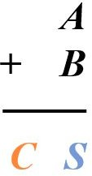
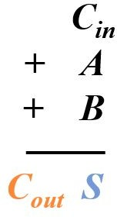
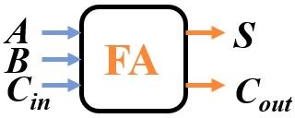
Implementing an Adder using a Decoder
Adder Type | Block Diagram | Working
Half Adder
Full Adder

Slide 26
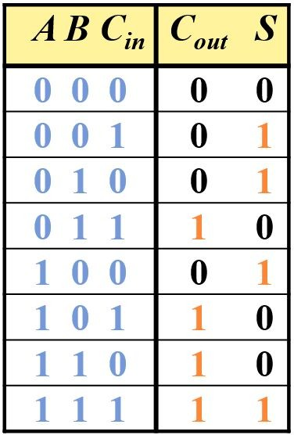
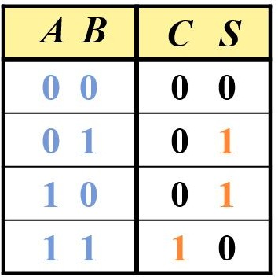
Implementing an Adder using a Decoder
Half Adder | Full Adder

Slide 27
Implementing an Adder using a Decoder
Lets implement a full adder using a 3-to-8 Line Decoder.
S(x, y, z) = ∑m(1, 2, 4, 7)
C(x, y, z) = ∑m(3, 5, 6, 7)

Slide 28
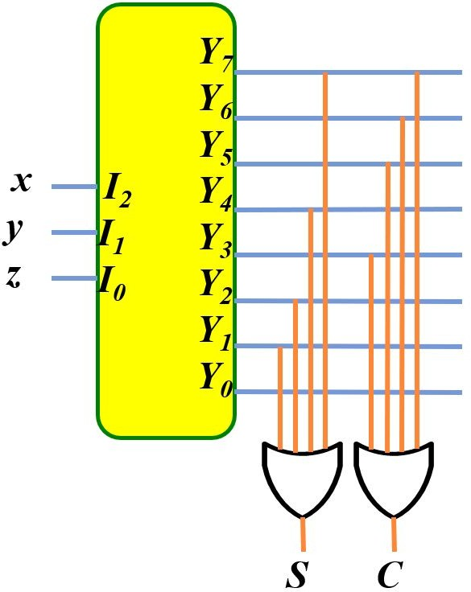
Implementing an Adder using a Decoder
Lets implement a full adder using a 3-to-8 Line Decoder.
S(x, y, z) = ∑m(1, 2, 4, 7)
C(x, y, z) = ∑m(3, 5, 6, 7)

Slide 29


Implementing an Adder using a Decoder
Now, implement a half adder using a 2-to-4 Line Decoder.
S(x, y) = ∑m(1, 2)
C(x, y) = ∑m(3)

Slide 30
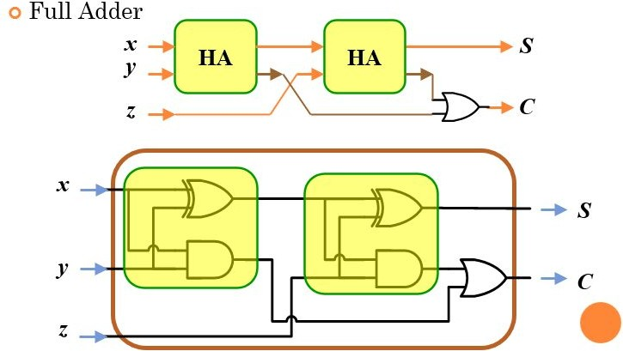
Full Adder using Half Adder

Slide 31
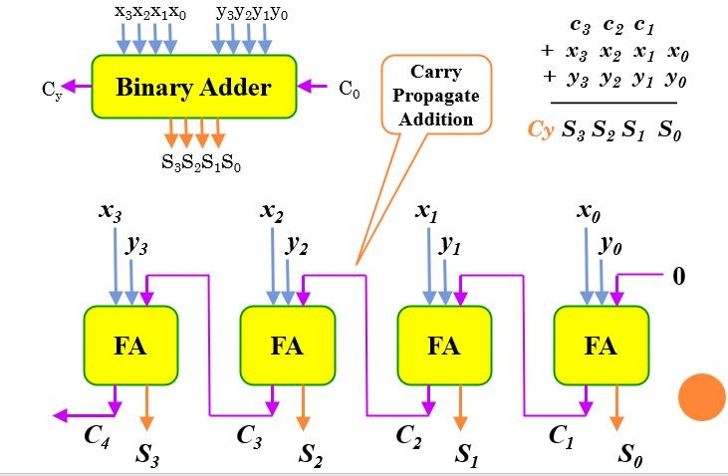
Binary Adder

Slide 32
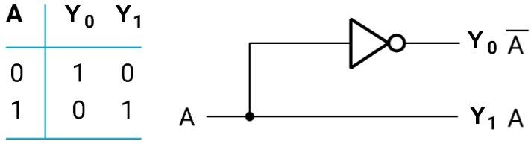
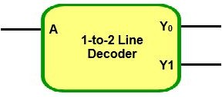
1-to-2 Line Decoder

Slide 33

We are done with basics of Decoders…
Now let's solve some problems!

Slide 34
Now, Can You Implement a 2-to-4 Line Decoder using two 1-to-2 Line Decoders?

Slide 35
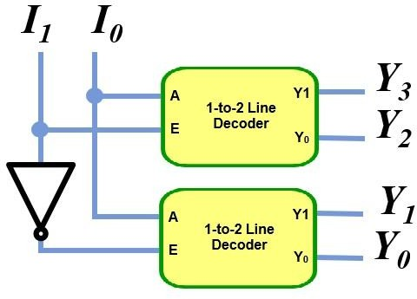
Now, Can You Implement a 2-to-4 Line Decoder using two 1-to-2 Line Decoders?
Active-High

Slide 36
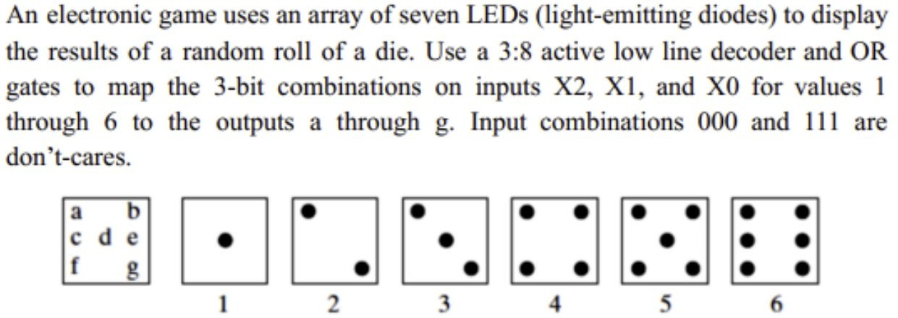
Solve this Problem

